Slide 1
PERFORMANCE PARAMETERS
ANUSHA N

Slide 2
PERFORMANCE
Bandwidth
Throughput
Latency (Delay)
Transmission time

Slide 3
PERFORMANCE -Bandwidth
I Bandwidth in Hertz
Bandwidth in hertz is the range of frequencies contained in a composite signal or the range of frequencies a channel can pass.
For example, we can say the bandwidth of a subscriber telephone line is 4 Khz
II Bandwidth in Bits per Seconds
The term bandwidth can also refer to the number of bits per second that a channel, a link, or even a network can transmit.
For example, 100 Mbps.

Slide 4
PERFORMANCE -Throughput
The throughput is a measure of how fast we can actually send data through a network.
Bandwidth in bits per second and throughput seem the same, they are different.
A link may have a bandwidth of B bps, but we can only send T bps through this link with T always less than B.
In other words, the bandwidth is a potential measurement of a link;
the throughput is an actual measurement of how fast we can send data.
Imagine a highway designed to transmit 1000 cars per minute from one point
to another. However, if there is congestion on the road, this figure may be reduced to 100 cars per minute. The bandwidth is 1000 cars per minute; the throughput is 100 cars per minute.

Slide 5
PERFORMANCE -Throughput
A network with bandwidth of 10 Mbps can pass only an average of 12,000 frames per minute with each frame carrying an average of 10,000 bits. What is the throughput of this network?
We can calculate the throughput as
Throughput= 12,000 x 10,000/60 =2 Mbps
The throughput is almost one-fifth of the bandwidth in this case..

Slide 6
PERFORMANCE – Latency
Latency (Delay)
The latency or delay defines how long it takes for an entire message to completely arrive at the destination from the time the first bit is sent out from the source.
We can say that latency is made of four components:
Propagation Time,
Transmission Time,
Queuing Time And
Processing Delay.
Latency =propagation time +transmission time +queuing time + processing delay

Slide 7
Latency - 1.Propagation Time
Propagation time measures the time required for a bit to travel from the source to the destination.
The propagation time is calculated by dividing the distance by the propagation speed.
Propagation time = Distance /Propagation speed

Slide 8
Latency - 2. Transmission Time
In data communications we don't send just 1 bit, we send a message.
The first bit may take a time equal to the propagation time to reach its destination; the last bit also may take the same amount of time.
However, there is a time between the first bit leaving the sender and the last bit arriving at the receiver.
The first bit leaves earlier and arrives earlier; the last bit leaves later and arrives later.
The time required for transmission of a message depends on the size of the message and the bandwidth of the channel.
Transmission time =Message size/Bandwidth

Slide 9
Latency - 3. Queuing Time
Queuing time is the time needed for each intermediate or end device to hold the message before it can be processed.
The queuing time is not a fixed factor; it changes with the load imposed on the network.
When there is heavy traffic on the network, the queuing time increases.
An intermediatse device, such as a router, queues the arrived messages and processes them one by one. If there are many messages, each message will have to wait

Slide 10
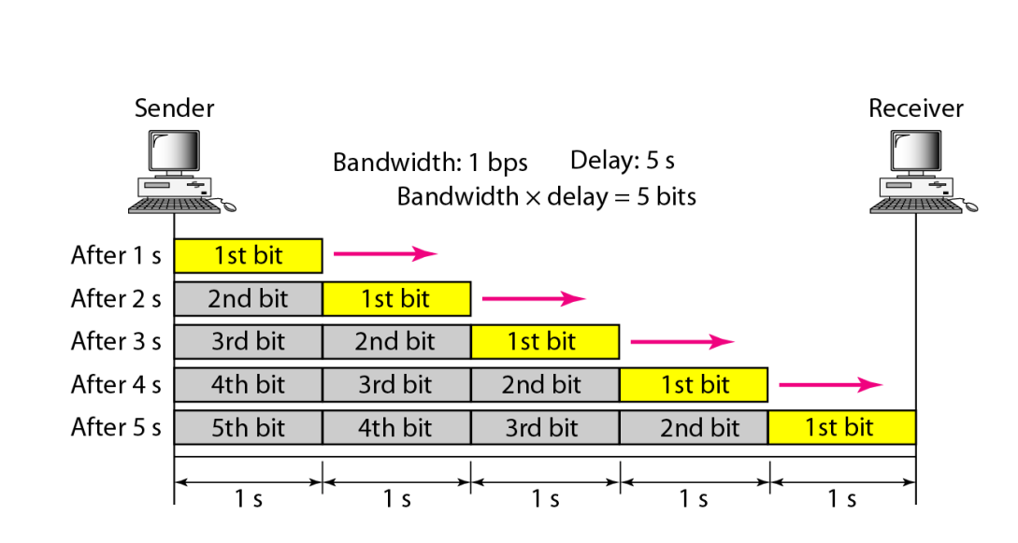
Latency - 4. Bandwidth-Delay Product
Bandwidth and delay are two performance metrics of a link

Slide 11
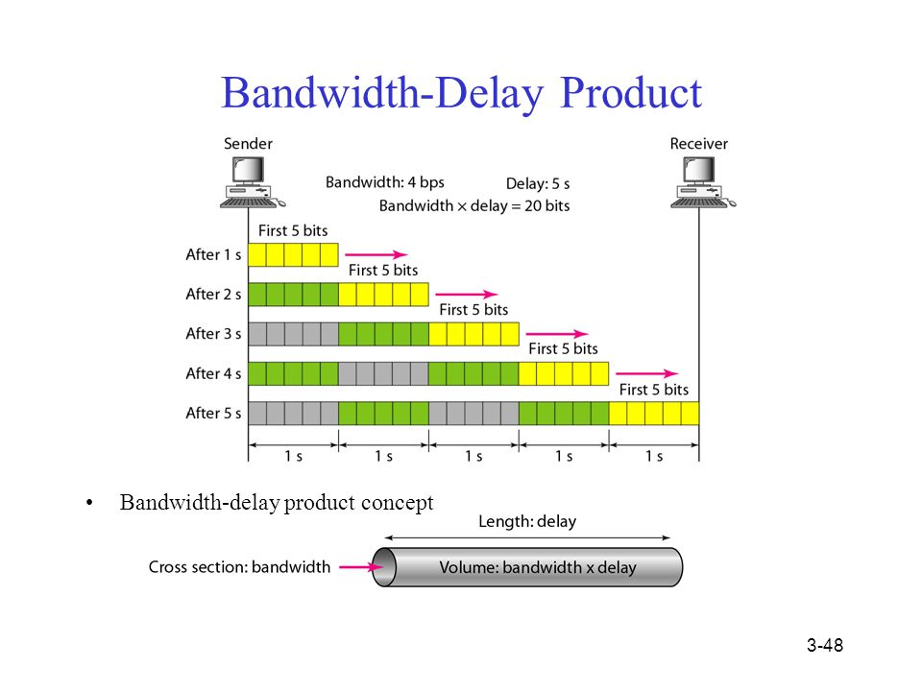
Latency - 4. Bandwidth-Delay Product
Bandwidth and delay are two performance metrics of a link

Slide 13
Jitter
Another performance issue that is related to delay is jitter.
jitter is a problem if different packets of data encounter different delays and the application using the data at the receiver site is time-sensitive (audio and video data, for example).
If the delay for the first packet is 20 ms, for the second is 45 ms, and for the third is 40 ms, then the real-time application that uses the packets endures jitter

Slide 14
Formulas to remember

Slide 15
Practice Problems …… Contd

Slide 17
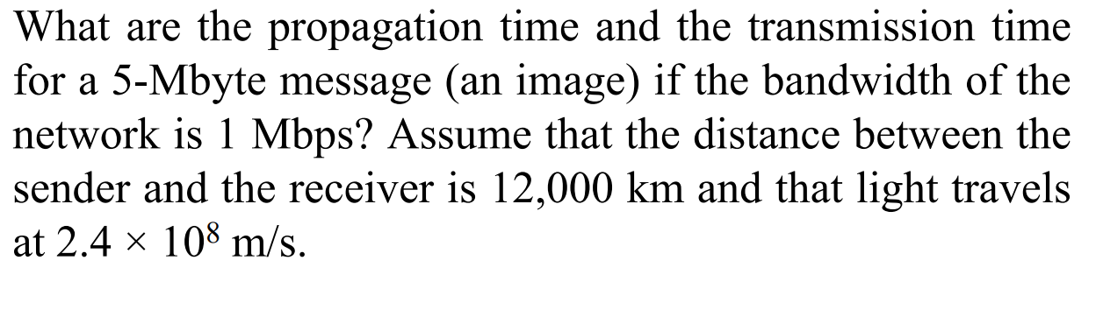
Practice Problems …… Contd

Slide 19
Practice Problems …… Contd

Slide 20
Practice Problems …… Contd

Slide 21
Practice Problems …… Contd
A network has a bandwidth of 10 Mbps and a round-trip delay of 50 ms. What is the Bandwidth Delay Product?
BDP = Bandwidth x Round-trip Delay BDP =10Mbpsx 50 ms BDP = 1,250 bytes

Slide 22
Practice Problems …… Contd
A network has a bandwidth of 100 Mbps and a round-trip delay of 10 ms. What is the Bandwidth Delay Product?
BDP = Bandwidth x Round-trip Delay BDP = 100 Mbps x 10 ms BDP = 12,500 bytes

Slide 23
Practice Problems …… Contd
A network has a bandwidth of 1 Gbps and a round-trip delay of 1 ms. What is the Bandwidth Delay Product?
BDP = Bandwidth x Round-trip Delay BDP = 1 Gbps x 1 ms BDP = 125,000 bytes
As we can see from these examples, the Bandwidth Delay Product is dependent on both the bandwidth and round-trip delay of the network. The higher the bandwidth and lower the delay, the larger the Bandwidth Delay Product.

Slide 24
Practice Problems …… Contd
What is the transmission time of a packet sent by a station if the length of the packet is 1 million bytes and the bandwidth of the channel is 200 Kbps?

Slide 25
Practice Problems …… Contd
What is the length of a bit in a channel with a propagation speed of 2 x 10⁸ mls if the channel bandwidth is
a. 1 Mbps
b. 10 Mbps
c. 100 Mbps?

Slide 26
Practice Problems …… Contd
What is the length of a bit in a channel with a propagation speed of 2 x 10⁸ mls if the channel bandwidth is
a. 1 Mbps
b. 10 Mbps
c. 100 Mbps?

Slide 27
Practice Problems …… Contd
How many bits can fit on a link with a 2 ms delay if the bandwidth of the link is
a. 1 Mbps
b 10 Mbps
c. 100 Mbps?

Slide 28
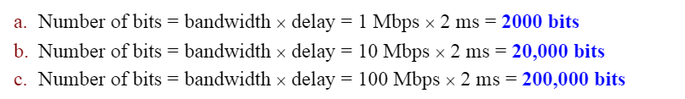
Practice Problems …… Contd
How many bits can fit on a link with a 2 ms delay if the bandwidth of the link is
a. 1 Mbps
b h. 10 Mbps
c. 100 Mbps?

Slide 29
Practice Problems …… Contd
What is the total delay (latency) for a frame of size 5 million bits that is being sent on a link with 10 routers each having a queuing time of 2 microsecs and a processing time of 1 microsecs. The length of the link is 2000 Km. The speed of light inside the link is 2 x 10⁸ m/s. The link has a bandwidth of 5 Mbps. Which component of the total delay is dominant? Which one is negligible

Slide 30
Practice Problems …… Contd
What is the total delay (latency) for a frame of size 5 million bits that is being sent on a link with 10 routers each having a queuing time of 2 microsecs and a processing time of 1 microsecs. The length of the link is 2000 Km. The speed of light inside the link is 2 x 108 m/s.The link has a bandwidth of 5 Mbps. Which component of the total delay is dominant? Which one is negligible

Slide 31
Practice Problems …… Contd
Calculate the latency (total delay from first bit sent to last bit received) for the following:
Sender and receiver are separated by two 1-Gigabit/s links and a single switch. The packet size is 5000 bits, and each link introduces a propagation delay of 10 microseconds. Assume that the switch begins forwarding immediately after it has received the last bit of the packet and the queues are empty
For each link,
it takes 1 Gigabits/5 Kbits = 5 microseconds to transmit the packet on the link,
after which it takes an additional 10 microseconds for the last bit to propagate across the link.
Thus, with only one switch that starts forwarding only after receiving the whole packet, the
total transfer delay is two transmit delays + two propagation delays = 30 microseconds.

Slide 32
Practice Problems …… Contd
Calculate the latency (total delay from first bit sent to last bit received) for the following:
Sender and receiver are separated by four 1-Gigabit/s links and 3 switch. The packet size is 5000 bits, and each link introduces a propagation delay of 10 microseconds. Assume that the switch begins forwarding immediately after it has received the last bit of the packet and the queues are empty
For each link,
it takes 1 Gigabits/5 Kbits = 5 microseconds to transmit the packet on the link,
after which it takes an additional 10 microseconds for the last bit to propagate across the link.
Thus, with only one switch that starts forwarding only after receiving the whole packet, the
For three switches and thus four links, the
total delta is four transmit delays + four propagation delays = 60 microseconds.

Slide 33
Recap of formulas
Volume = Bandwidth * Delay
Bit duration is inverse of Bandwidth

Slide 37
Figure shows a switch (router) in a datagram network. Find the output port for packets with the following destination addresses: Packet 1: 7176 Packet 2: 1233 Packet 3: 8766 Packet 4: 9144

Slide 38
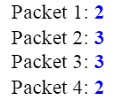
Figure shows a switch (router) in a datagram network. Find the output port for packets with the following destination addresses: Packet 1: 7176 Packet 2: 1233 Packet 3: 8766 Packet 4: 9144

Slide 39
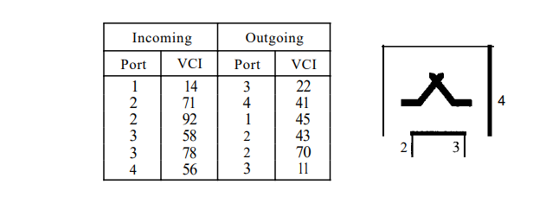
Find the output port and the output VCI for packets with the following input port and input VCI addresses: Packet 1: 3, 78 Packet 2: 2, 92 Packet 3: 4, 56 Packet 4: 2, 71

Slide 40
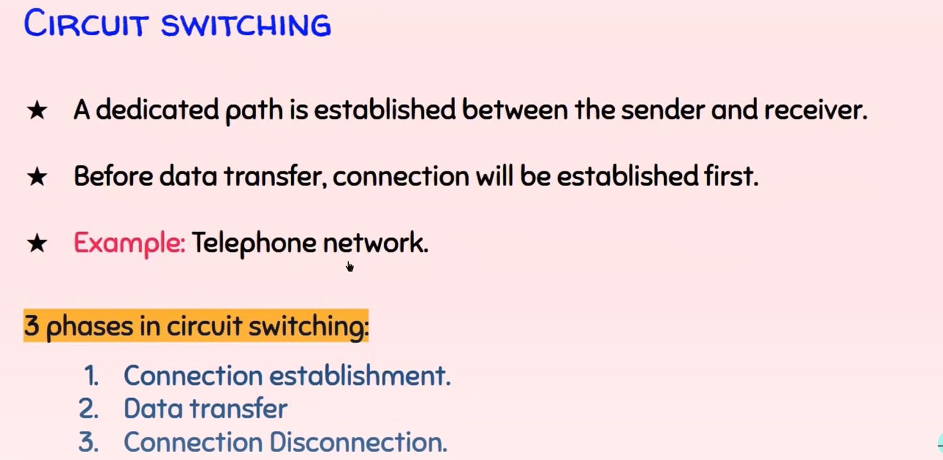

Slide 41
Recap of formulas
Volume = Bandwidth * Delay
Bit duration is inverse of Bandwidth

Slide 42
Points to remember
Total time = Set uptime + Data Transfer+ Teardown phase
Total time = Set uptime + Transmission delay+ propagation delay + Teardown phase
Setup phase two way communication hence two propagation delays and Transmission delays are needed.
Teardown phase one way communication so 1 propagation delay and Transmission delays needed.
For setup and teardown we need minimum size packet to be exchanged between A to B.
For Data transfer 1 propagation and 1 transmission delay are needed as the same way for setup and teardown phases.

